Slide 1

Anki
Presentation by Taha Rashid
28/05/2024
Notes:
Image:
https://play.google.com/store/apps/details?id=com.ichi2.anki&hl=en_US&pli=1

Slide 2
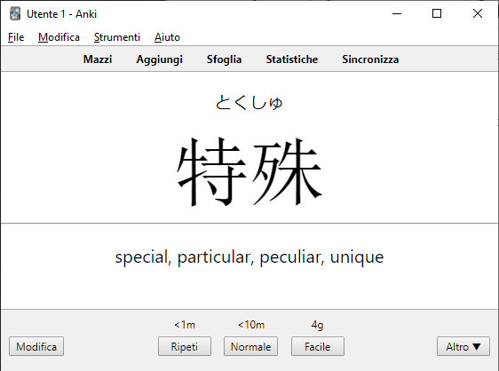
What is Anki?
Anki is a flashcard program designed to help you remember information
The idea is similar to apps like Quizlet or Kahoot (a gamified version) which are also flashcard apps, but Anki has many more features
Notes:
Sources:
https://www.ama-assn.org/medical-students/usmle-step-1-2/what-anki
https://apps.ankiweb.net/
Image:
https://community.wanikani.com/t/jankigen-anki-deck-generation-from-japanese-text/44225

Slide 3
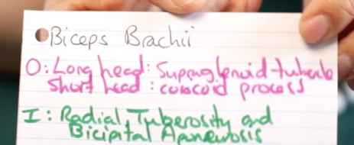
How Flashcards Work
Flashcards typically have two sides to them (a face and a backside)
The face card typically has a short prompt. This is where you should try to recall the information. The backside typically has the answer/information associated with the prompt
You typically always want to try to recall and see the answer to reinforce your memory
When making an ideal flashcard, they should have information that makes sense to YOU that is short and concise (basically only the important/core information)
Notes:
Sources:
https://usm.maine.edu/learning-commons/using-flash-cards/#:~:text=Flashcards%20are%20small%20note%20cards,vocabulary%2C%20concepts%2C%20or%20procedures.
Images:
https://usm.maine.edu/learning-commons/using-flash-cards/#:~:text=Flashcards%20are%20small%20note%20cards,vocabulary%2C%20concepts%2C%20or%20procedures.

Slide 4
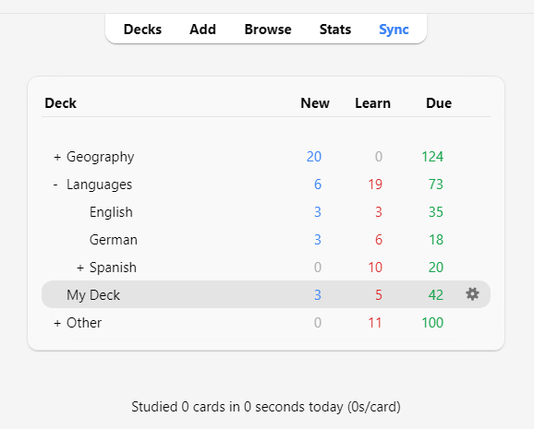
How Anki Works
A critically distinguishing difference between Anki and other flashcard apps is that Anki uses a method called spaced repetition to help users remember information
Spaced repetition is “an evidence-based learning technique that optimizes memory retention and recall” (American Medical Association)
It basically shows users flashcards right before they forget them, allowing users to recall flashcards more effectively in the future (Anki)
Notes:
Sources:
https://www.ama-assn.org/medical-students/usmle-step-1-2/what-anki
https://apps.ankiweb.net/
Images:
https://docs.ankiweb.net/studying.html

Slide 5
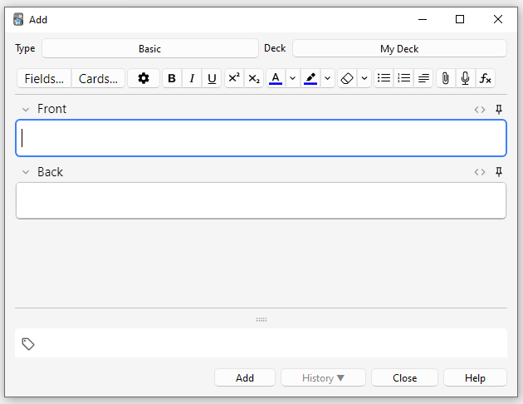
Features of Anki
It is multiplatform, available on Windows, Mac, Linux, Android, iOS and web browsers. Your cards and progress can automatically sync between platforms
Because of Anki’s age (released in 2006), there are a lot of pre-built flashcard decks (importantly, lots of QUALITY decks) that you can download compared to other apps
It is also very optimized, allowing Anki to “handle decks of 100,000+ cards with no problems” (Anki)
Anki is very customizable, media-rich and open, being able to handle all sorts of files from audio, images, plain text, LaTeX and HTML among other things. You can customize the way your cards are shown and presented as well
Addons are a key feature of Anki, allowing users to create, modify and interact with their cards and Anki clients in new, convenient and improved ways. Similarly due to Anki’s age, there are lots of extensions
Critically, Anki is open source and does not ask for any money in any way (though individuals may ask for money when requesting addons or decks, but I have personally seen that this is extremely rare)
Notes:
Sources:
https://apps.ankiweb.net/
https://en.wikipedia.org/wiki/Anki_(software)
Images:
https://docs.ankiweb.net/editing.html

Slide 6
Why Use Flashcards/Anki?
Flashcards are an easy way to condense/simplify complex notes and ideas
Even making the flashcards is a form of studying as you have to understand, read, and condense your notes into its core ideas that YOU will personally understand
They allow people a easy and quick way to remember information
You can use them in any period of time that you have, short or long. Ex. Lunch breaks
They are easy to make and are powerful learning tools
Anki’s premade decks and plethora of extensions make it easy to make cards
Anki allows you to learn on any device for free
Spaced repetition (which Anki implements) is a proven way to recall more information faster
Notes:
Sources:
https://usm.maine.edu/learning-commons/using-flash-cards/#:~:text=Flashcards%20are%20small%20note%20cards,vocabulary%2C%20concepts%2C%20or%20procedures.
https://apps.ankiweb.net/
https://www.ama-assn.org/medical-students/usmle-step-1-2/what-anki

Slide 7
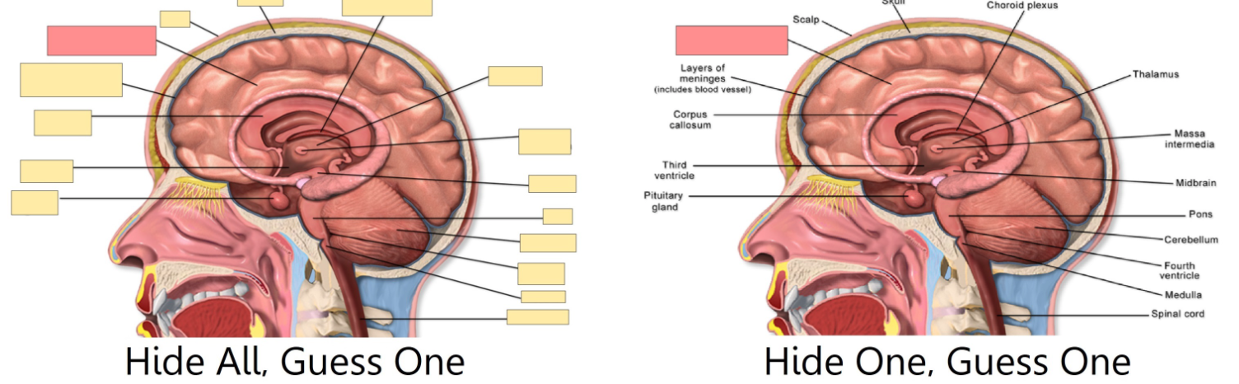
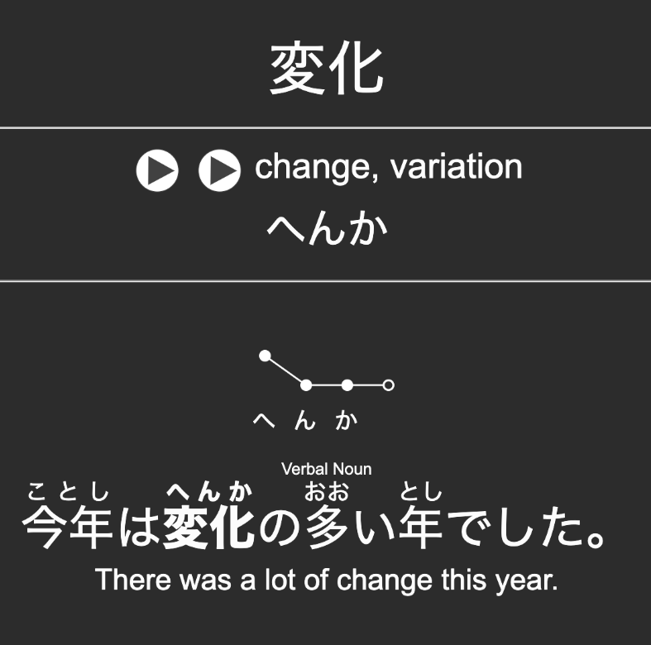
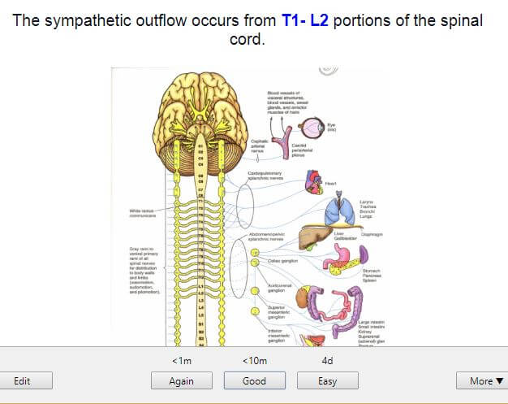
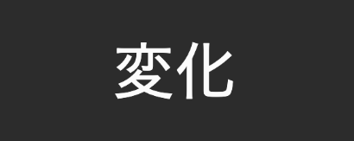
Examples
Medical student notes
Backside of a language card
Front of a language card
Notes:
Images:
https://docs.ankiweb.net/editing.html
https://moinulkarim.com/how-to-use-anki-for-medical-school/

Slide 8
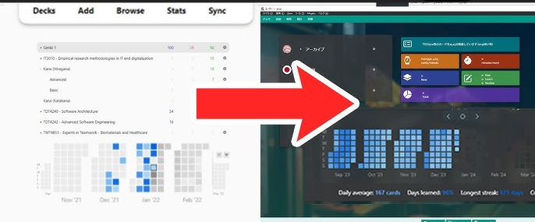
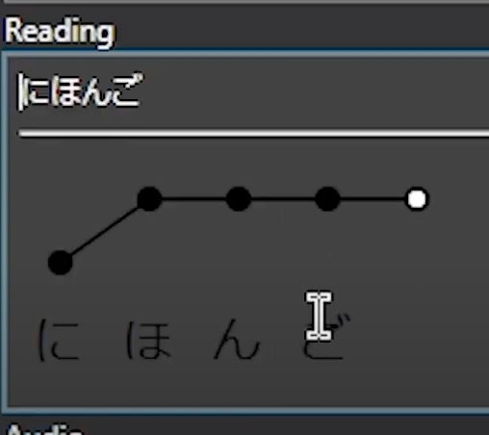
What are Addons + Why they Are Good
Addons are what they sound like: extensions to Anki that change it in some form, similar to Chrome Extensions
They allow users to interact with their Anki cards and decks in new ways
Ex. Support for foreign languages
Can interact with external apps/programs
Ex. Chrome Extensions
Creates convenience as they can add/remove extra information based on pre-existing information in your cards
Ex. Each one of my cards has the name of a country, and I have an extension that will read the country name and then add a map of that country in that card, and I can do this to every single card I have in a matter of seconds
Addon to make Anki look better
Addon to automatically create pronunciation diagram based on the above text
Notes:
Sources:
https://docs.ankiweb.net/addons.html
Images:
https://www.youtube.com/watch?app=desktop&v=ahGkFX4JPc8

Slide 9
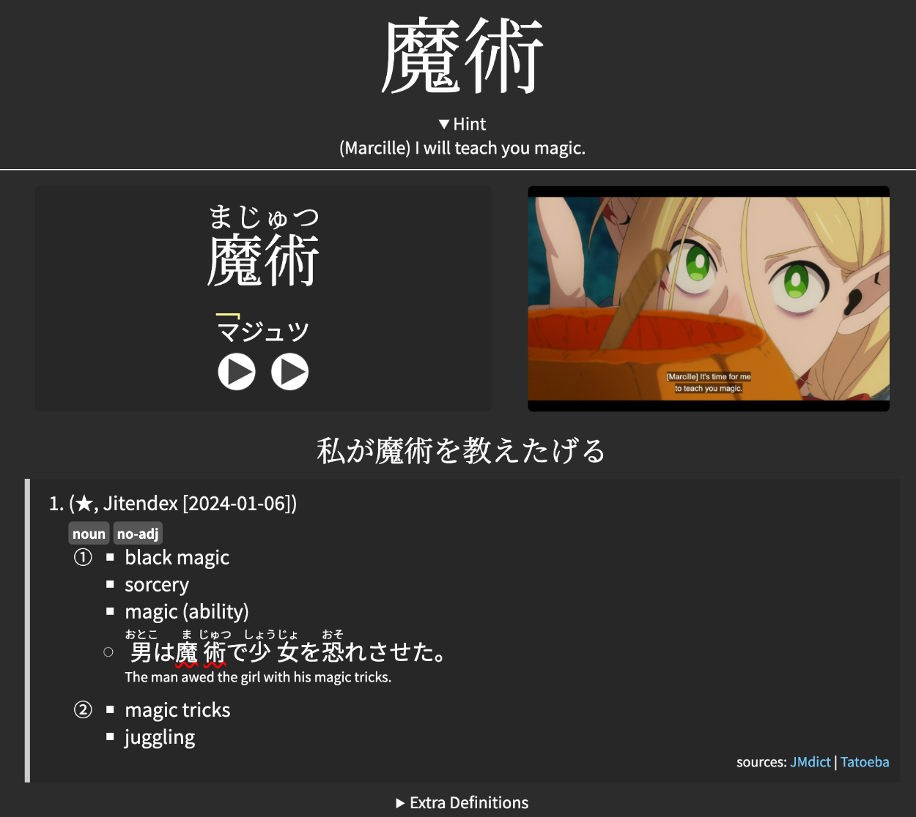
An addon created this entire card
I chose a word in the Japanese subtitle I wanted to create a card of, and it:
Automatically took a screenshot of the scene
Created spelling and a pronunciation chart
Gave the definitions and type of word with example sentences
Displayed the sentence in Japanese (which was translated into English using another addon)
Saved an audio clip of the TV show and added a native speaker’s audio recording of the same word

Slide 10
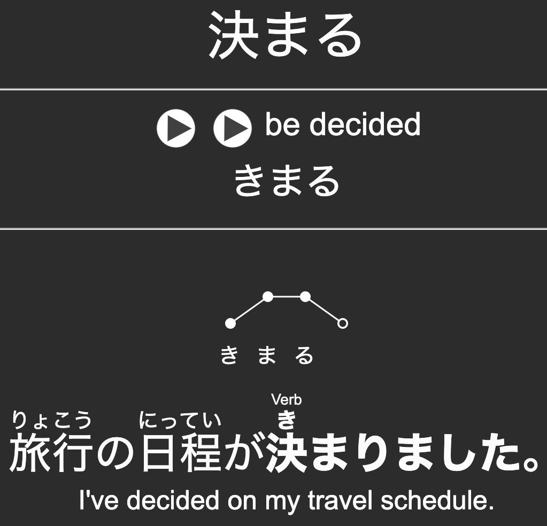
My Problem (and Solution)
I was trying to learn Japanese using premade decks. I modified the decks to make them more personal and to add extra information using addons (such as the pronunciation of words and better meanings)
The premade deck I was using (in short) does not clarify if a word is a specific type of verb (intransitive or transitive) and I could not find any extension that could modify each card and add the correct information
Therefore, I plan to create an Anki extension that takes the word from each card in my deck, scrapes/searches the web for it’s correct type and add the correct information to each card
Doesn’t specify what time of verb it is (intransitive or transitive?)

Slide 11

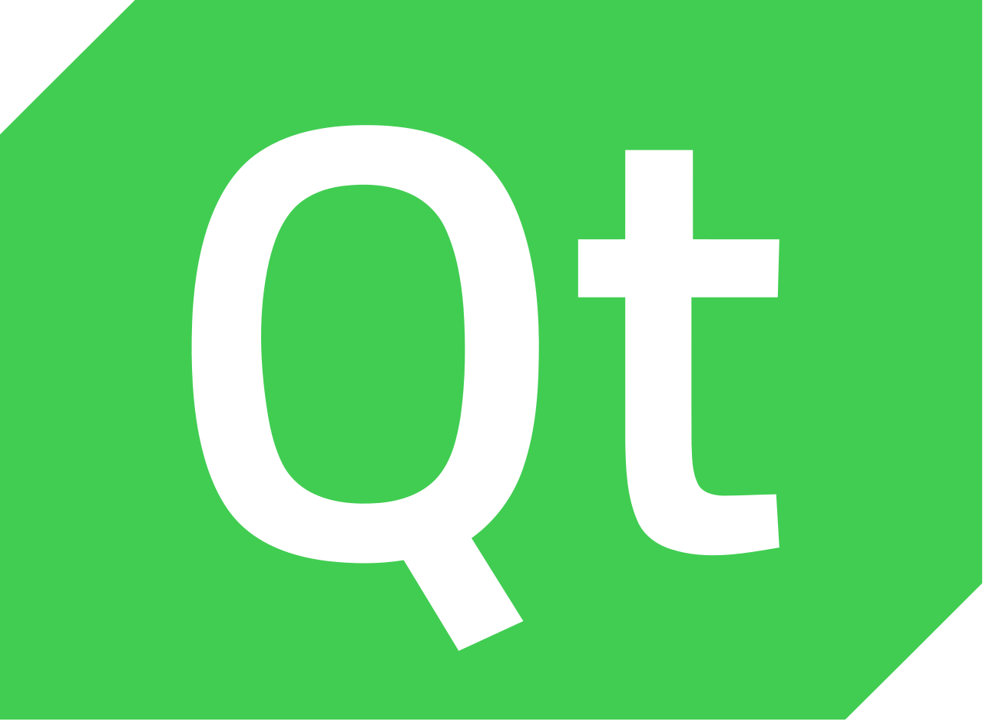
How My Anki Addons Will Be Made
Anki addons are all made in Python, and its interface is made in Qt6
I will be using Anki’s documentation to create my addon in Python with the qt/anki library (to interface with Anki)
I will also need to create a web scraper that:
Searches a dictionary website
Finds the line of text that specifies the type of verb
Extracts and save it
This will also be done in Python using the urllib3 library (to scrape a webpage) and BeautifulSoup library (to parse the webpage)
I have some prior experience in coding Python, and some prior experience in scraping web pages but only in Javascript. Most of this will me new to me
Notes:
Sources:
https://addon-docs.ankiweb.net/#:~:text=Add%2Dons%20in%20Anki%20are,when%20those%20actions%20take%20place.
Images:
https://bcairns.medium.com/learn-c-qt-and-qml-the-easy-way-8d2fb830fb2d
https://commons.wikimedia.org/wiki/File:Python_logo_and_wordmark.svg

